Slide 1

Retail Insights from Superstore Data
BY,
PAL SATYAM GYANCHAND
ADITYA SILVER OAK INSTITUTE OF TECHNOLOGY, GOTA, AHMEDABAD, GUJARAT - 382480
VOIS & Batch 4 AICTE Internship [JUNE-JULY 2024]

Slide 2

PROBLEM STATEMENT
The Superstore dataset provides sales and profit data for a variety of products across different categories and regions.
The goal of this project is to analyze the data and identify insights that can help the company improve its business performance.
Specifically, we aim to answer questions such as: which product categories are the most profitable? Which regions have the highest sales and profit? What are the most profitable products?
So our goal is clear to make proper Data Analysis of Super Store.

Slide 3
PROJECT DESCRIPTION
This project focuses on analyzing retail data from a superstore to derive valuable insights that can inform strategic decision-making. Using Power BI, various aspects of the retail data, including sales performance, inventory levels, and customer demographics, were examined to uncover trends and patterns.
The findings will support strategic decision-making and help the superstore maintain a competitive edge in the market. EDA Methodology is used to gain these insights from the dataset.

Slide 4
END USERS
Retail Managers: Use insights to optimize store operations and improve sales performance.
Sales Teams: Leverage data to develop targeted sales strategies and boost revenue.
Marketing Teams: Utilize customer behavior analysis to create effective marketing campaigns.
Inventory Managers: Monitor and manage stock levels to ensure efficient inventory turnover.
Business Analysts: Analyze data trends to support business strategy and decision-making.
Executive Leadership: Make informed strategic decisions based on comprehensive data insights.

Slide 5

TECHNOLOGY USED
Data Collection: Gathered data from the superstore dataset, including transactions, products, customers, and regions.
Data Cleaning: Processed raw data to handle missing values, remove duplicates, and ensure consistency.
Data Integration: Combined multiple datasets to create a unified view of retail operations.
Data Analysis: Utilized Power BI for descriptive and exploratory data analysis, creating various visualizations.
Dashboard Creation: Developed interactive dashboards in Power BI to enable dynamic exploration of data insights by stakeholders.

Slide 6
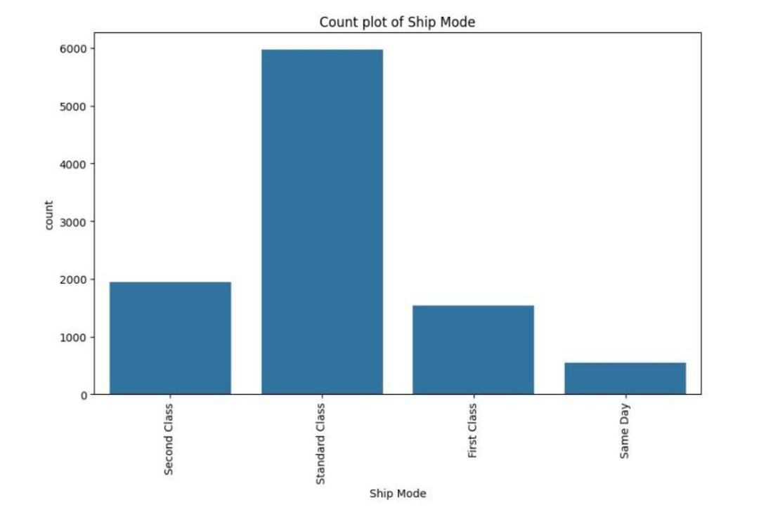
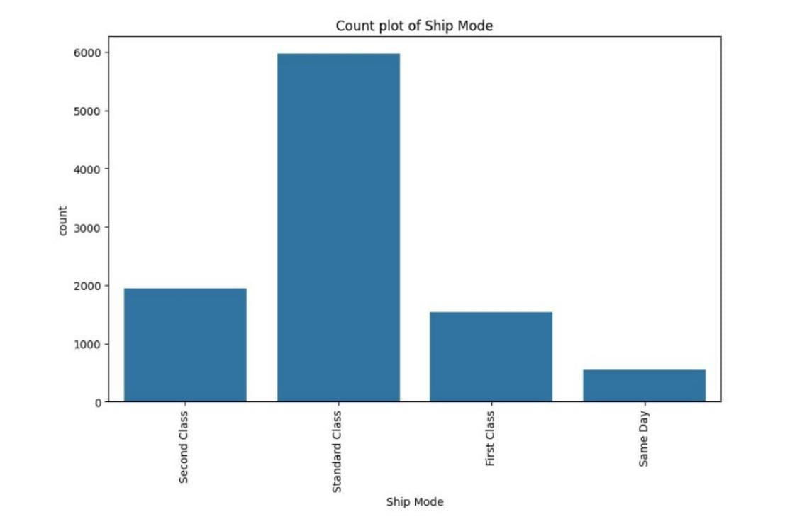
RESULTS
LINK: https://github.com/Satyam-pal31/intership_project

Slide 7
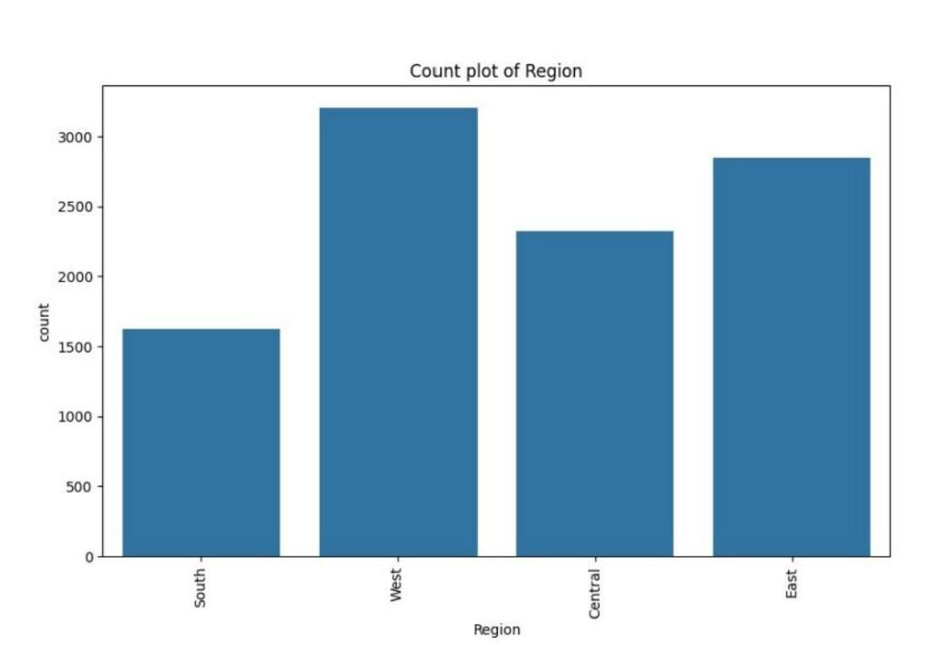
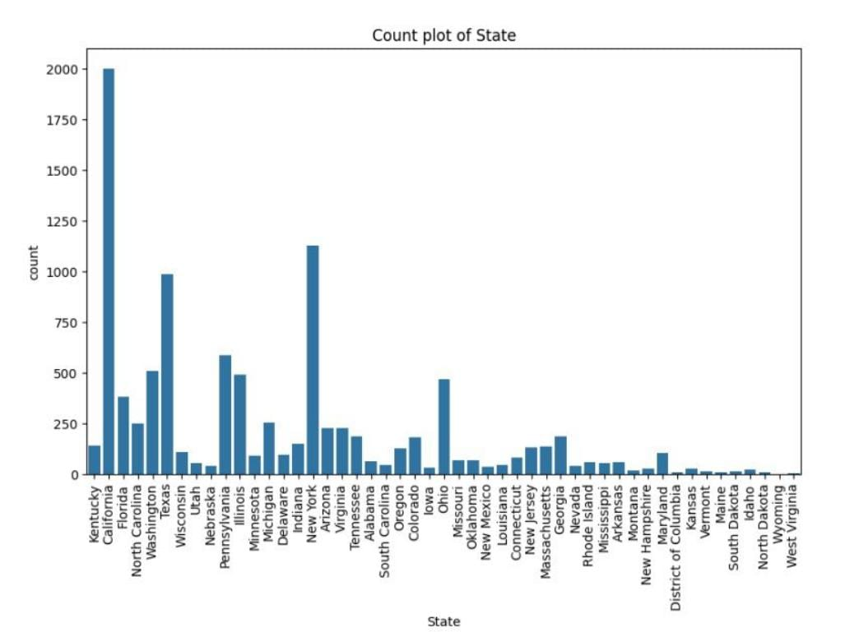

Slide 8
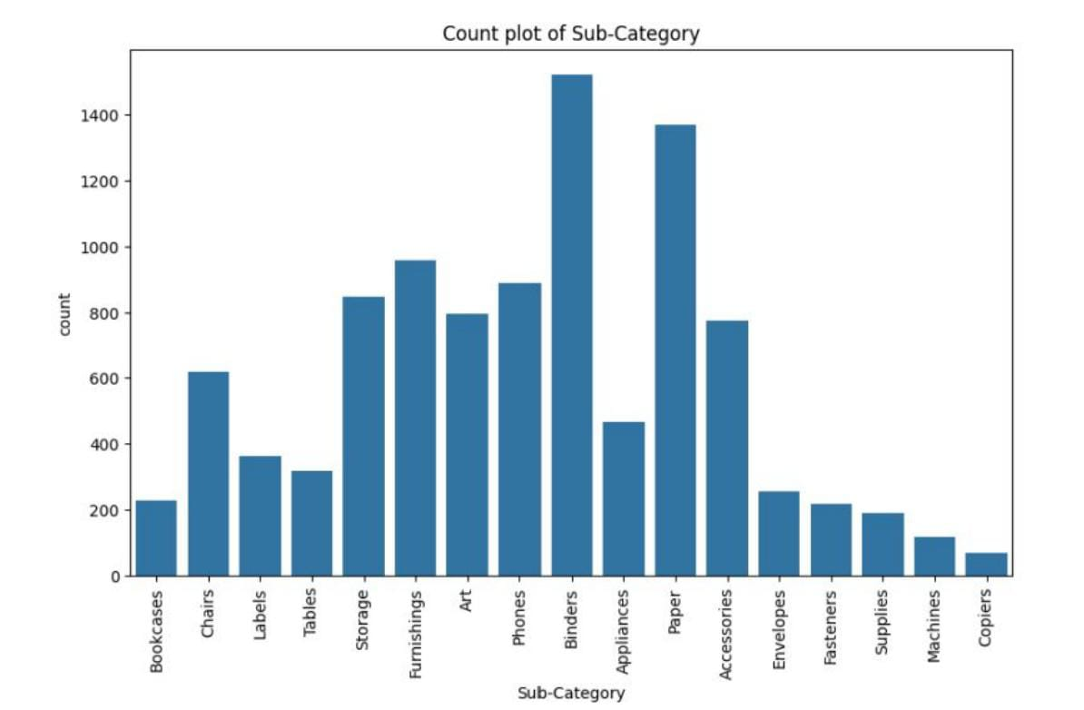
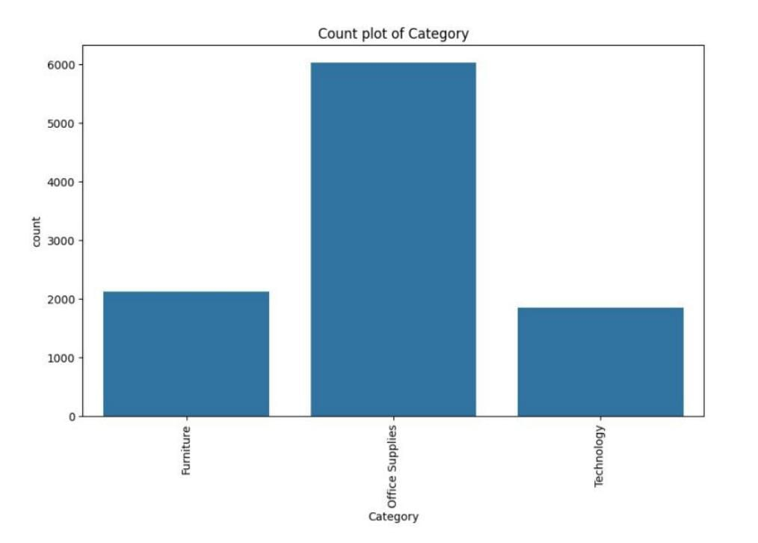

Slide 9
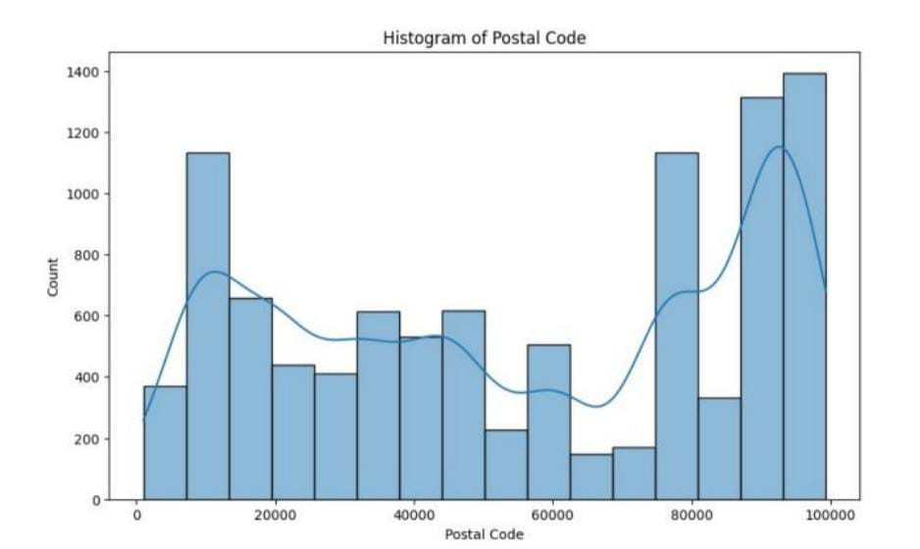
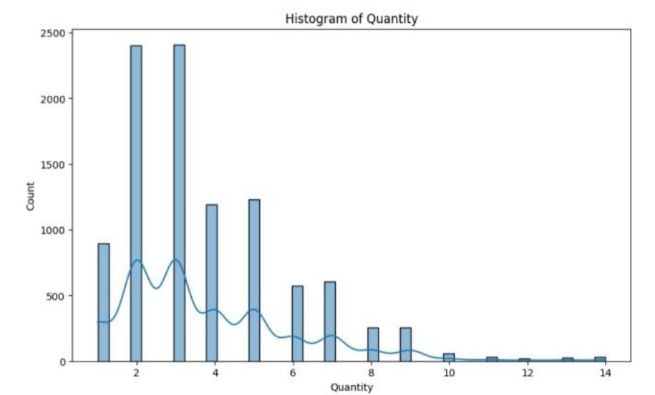

Slide 10
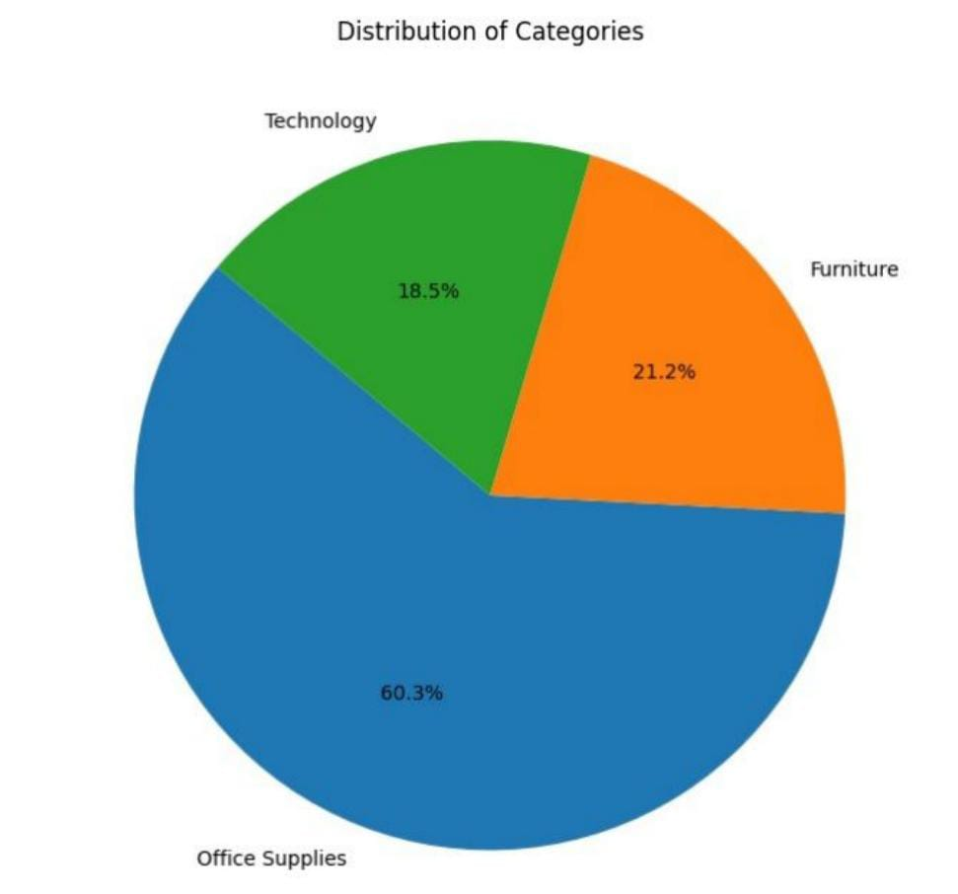

Slide 11
THANK YOU
.
.
LINK:
https://github.com/Satyam-pal31/intership_project

